Slide 1
Value Proposition Design Workshop

Slide 2
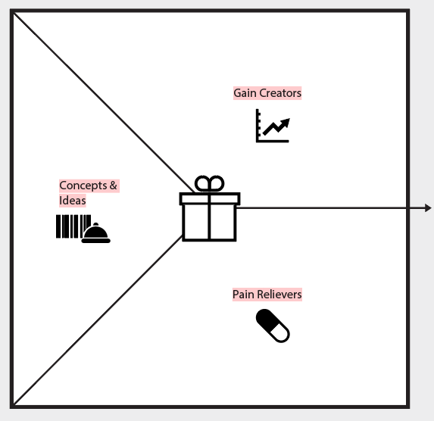
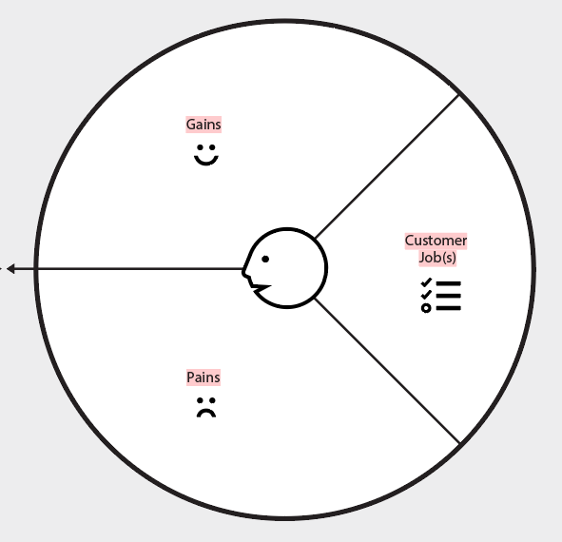
The Value Proposition Map
Create Value
The set of benefits that you design to attract participants
Observe participants
The set of characteristics that you assume,
observe and verify in the market

Slide 3
Participant Profile– 30 minutes
Put yourself into the shoes of Maritz employees and design from
their point-of-view
Move through each category:
What is their current experience?
Jobs
Pains
Gains

Slide 4
Participant Profile – Jobs
Jobs describe the things employees are trying to get done in their work or in their life. An employee job could be the tasks they are trying to perform and complete, the problems they are trying to solve, or the needs they are trying to satisfy.
What is the one thing that employees couldn’t
live without accomplishing?
What do employees need to accomplish that involves interaction with others?
What tasks are employees trying to perform in their work or personal life?
What emotional needs are employees
trying to satisfy?
How do employees want to be
perceived by others?
How do employees want to feel?
Examples: Improve a skillset, collaborate with others, stay up-to-date

Slide 5
Participant Profile – Pains
Pains describe anything that annoys employees before, during, and after trying to get a job done or simply prevents them from getting a job done. Pains also describe risks, that is, potential bad outcomes, related to getting a job done badly or not at all.
What makes employees feel bad?
What are the main difficulties and challenges employees encounter?
What negative social consequences do your participants encounter or fear? Are they afraid of a loss of face, power, trust, or status?
What’s keeping employees awake at night? What are their big issues, concerns, and worries?
What common mistakes do employees make?
What barriers are keeping employees from doing their job effectively
Examples: Lack of time, management not getting it, no clear path

Slide 6
Participant Profile – Gains
Gains describe the outcomes and benefits employees want. Some gains are required, expected, or desired by employees, and some would surprise them. Gains include functional utility, social gains, positive emotions, and cost savings.
Which savings would make employees happy?
(related to time, money and effort)
What would make employees’ jobs or
lives easier?
What positive social consequences do employees desire? What makes them look good?
What are employees looking for most? Are they searching for good design, guarantees, specific
or more features?
What do employees dream about? What do they aspire to achieve, or what would be a big relief to them?
How do employees measure success and failure?
Examples: Clear indicators to measure progress, get recognized by team, easy to understand

Slide 7
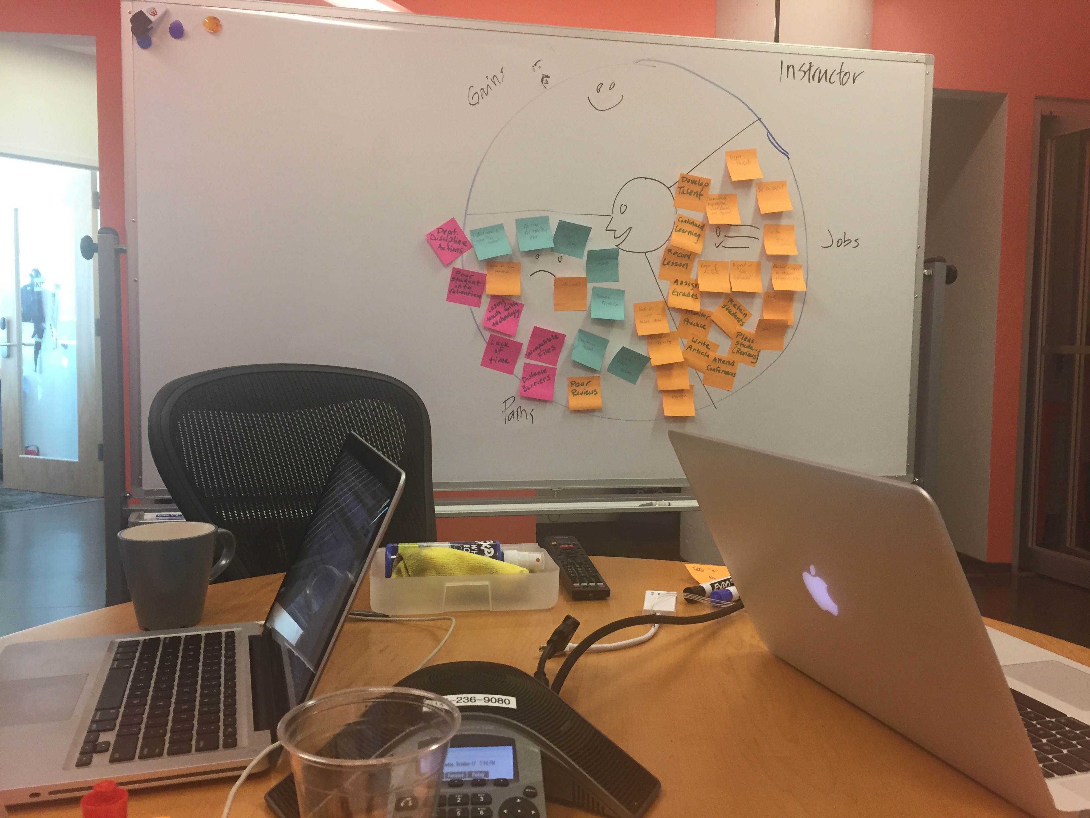

Slide 8
Rank Jobs, Pains, and Gains– 10 minutes
Identify the top 5 from each that our concepts will refer back to
Important
Extreme
Essential
Jobs
Pains
Gains
Insignificant
Moderate
Nice to have

Slide 9
Value Map– 30 minutes
Think about the value that’s needed
in order to address employees’
pains, gains and jobs.
Move through each category:
These will lead us to our concepts
and ideas
Pain Relievers
Gain Creators

Slide 10
Value Map– Pain Relievers
Pain relievers describe how your products and services alleviate specific employee pains. They outline how you intend to eliminate or reduce some of the things that annoy employees before, during, or after they are trying to complete a job or that prevent them from doing so.
Can we produce savings? (Time, money, effort)
Can we make employees feel better? By killing frustrations, annoyances, and other things that give participants a headache.
Can we fix under-performing solutions? By introducing new features, better performance, or enhanced quality.
Can we help employees better sleep at night? By addressing significant issues, diminishing concerns, or eliminating worries.
Can we limit or eradicate common mistakes employees make? By helping them use a
solution the right way.
Examples: Minimize the risk of failure, provide engaging material, integrate with other deliverables

Slide 11
Value Map– Gain Creators
Gain Creators describe how your products & services create participant gains. They outline how you intend to produce outcomes and benefits that your participant expects, desires, or would be surprised by, including functional utility, social gains, positive emotions, and cost savings.
Can we create savings that please your participants?
Can we produce outcomes your participants expect or that exceed their expectations? By offering quality levels, more of something, or less of something.
Can we make your participants’ work or life easier? Via better usability, accessibility, more services, or lower cost of ownership.
Can we create positive social consequences?
By making them look good or producing an increase in power or status.
Can we produce positive outcomes matching your participants’ success and failure criteria? In terms of better performance or lower cost
Examples: Help shape ideas, help understand what matters, share & learn from peers

Slide 12
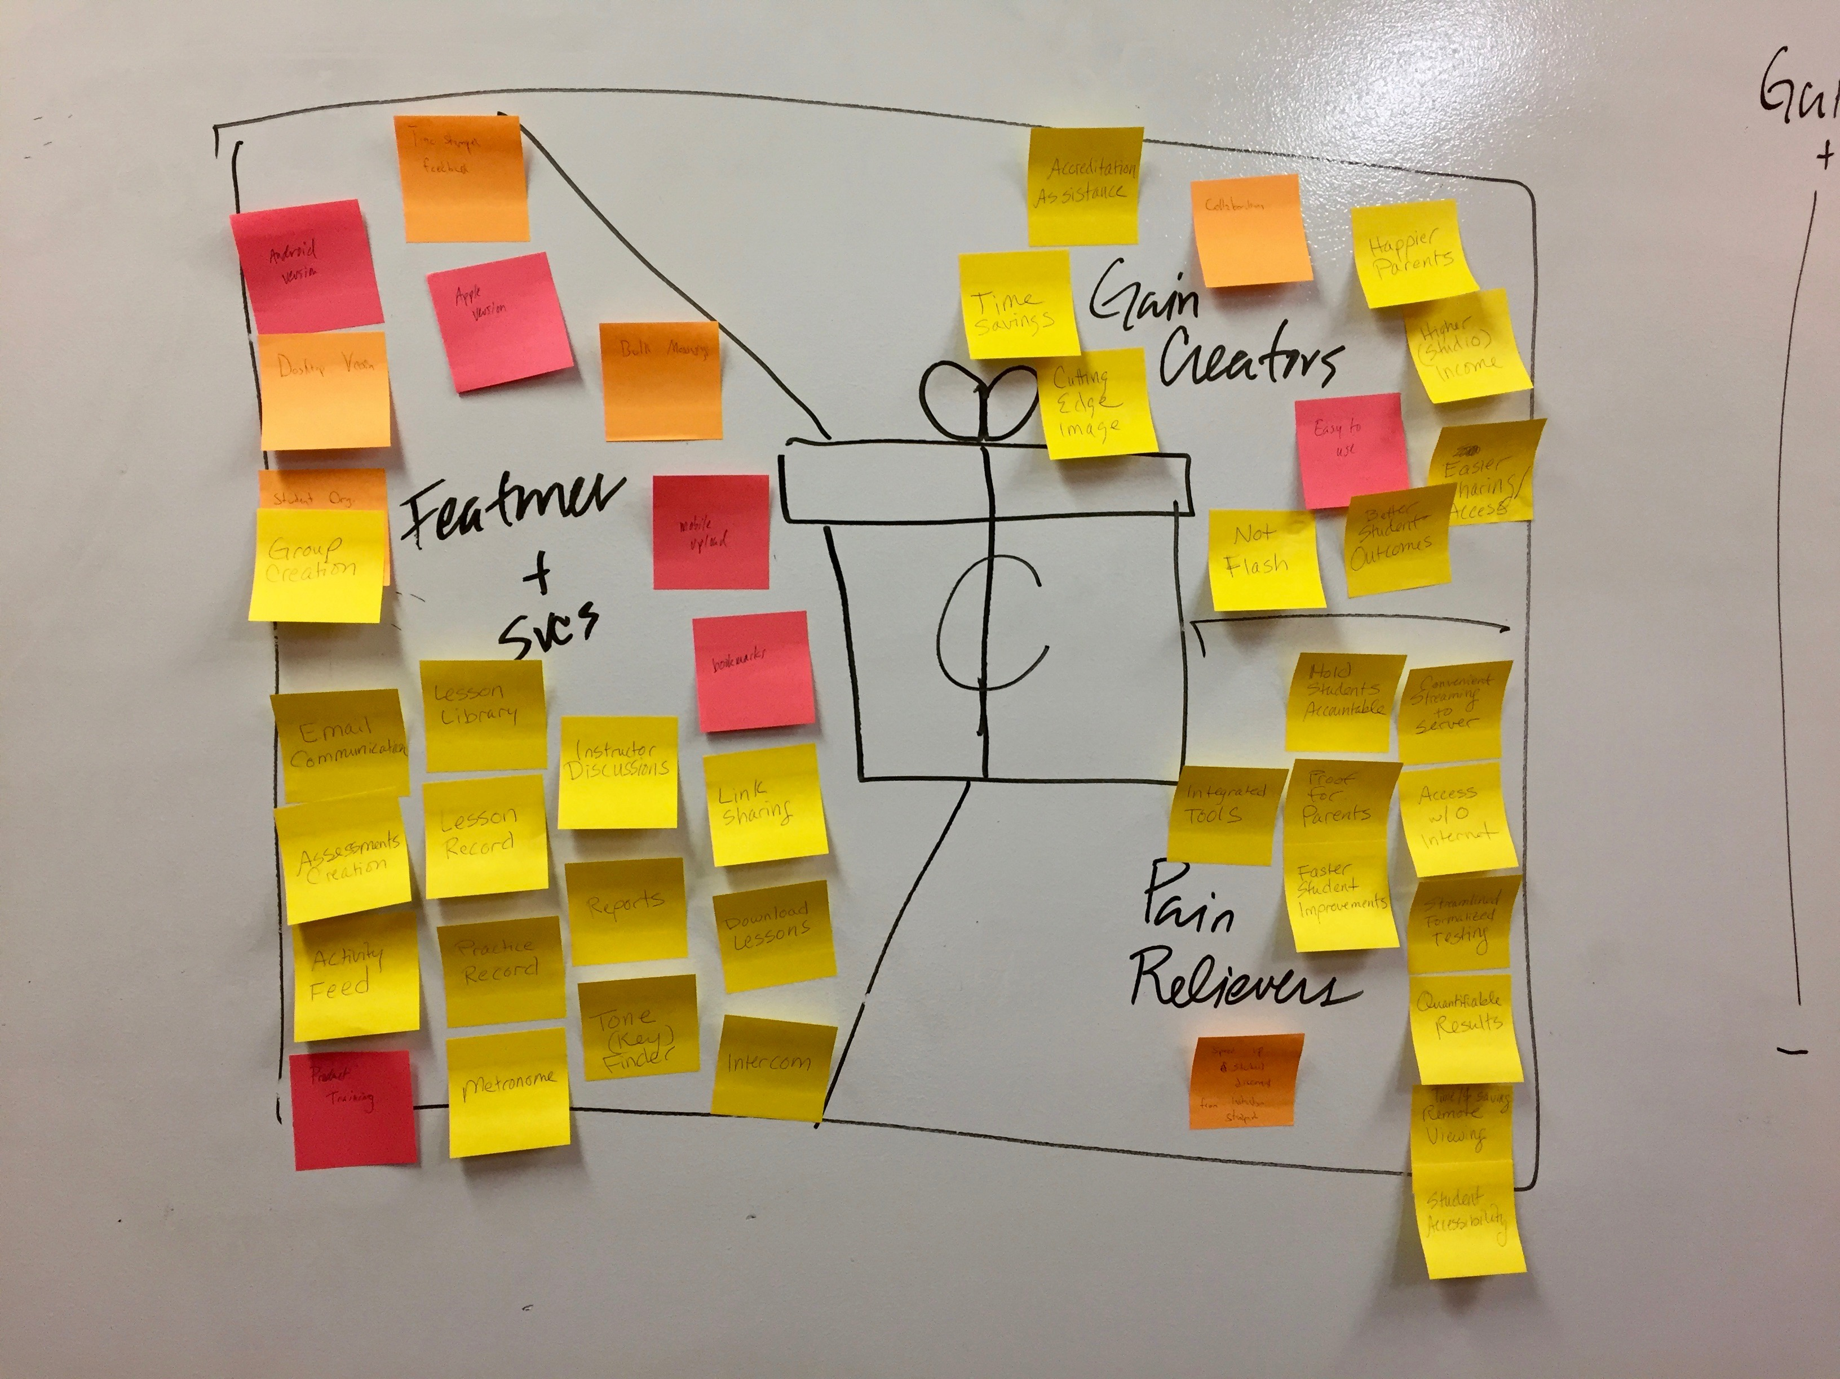

Slide 13
Rank Pain Relievers & Gain Creators– 10 minutes
Identify the top 5 from each that our concepts will refer back to
Essential
Essential
Pain Relievers
Gain Creators
Nice to have
Nice to have

Slide 14
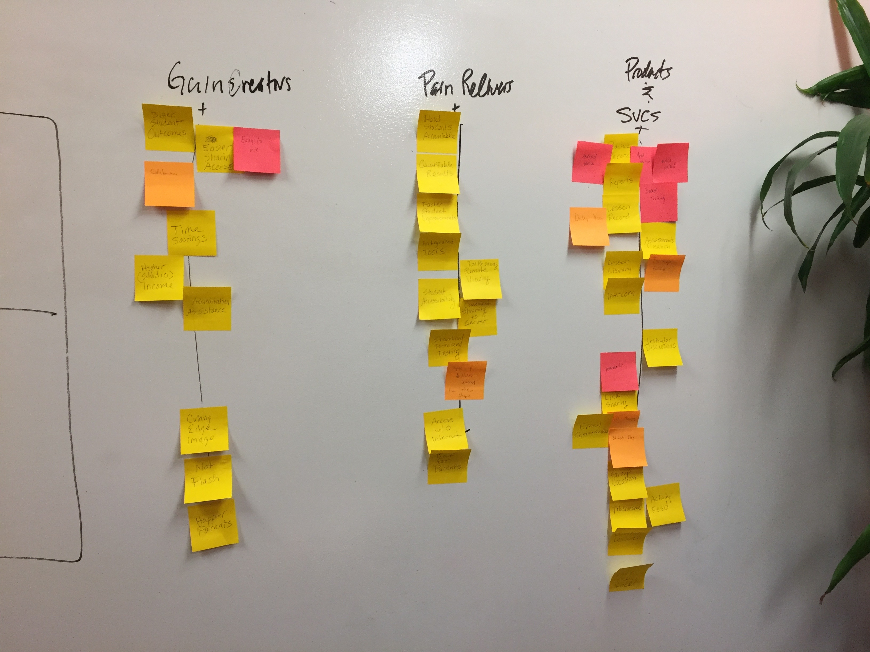

Slide 15
